Slide 1

Acquisition Data Integration
Summit Sporting Goods × PowerBite Nutrition
Building a unified analytics layer on Databricks Lakehouse to merge a startup acquisition into enterprise-grade reporting.

Slide 2


BUSINESS PROBLEM
Two Companies, Two Data Realities
Integrating PowerBite Nutrition's chaotic startup data into Summit Sporting Goods' mature analytics ecosystem.
🚀 Child — PowerBite Nutrition
Data chaos: CSVs, spreadsheets, inconsistent formats
Daily transaction volume
Missing values, dirty records, mismatched schemas
Parent — Summit Sporting Goods
Mature ERP data pipelines
Monthly reporting cadence
Existing gold analytics tables
Business Goal: One consolidated dashboard across both companies · Reliable metrics for revenue, quantity, and top products · Foundation for forecasting and inventory planning

Slide 3

ARCHITECTURE
Lakehouse Pipeline on Databricks
Medallion Architecture with a merge strategy — from raw ingestion to unified gold analytics.
Bronze — Raw
Silver — Cleansing
Gold — Unified
Child data flows through each medallion layer before merging into Summit's parent gold tables, powering dashboards and natural-language querying via Databricks Genie.
Bronze = Raw
Silver = Clean
Gold = BI-Ready
Append-only, full lineage
Validated, standardised
Unified model, merged

Slide 4

IMPACT
Key Engineering Challenges Solved
Challenge
Risk
Solution
Grain mismatch (daily vs monthly)
Inconsistent KPIs across companies
✅ Aggregate child orders to monthly grain before merge
Dirty / inconsistent data
Broken joins, unreliable reporting
✅ Silver cleansing: trim, dedupe, standardise, null handling
Unreliable IDs / schema mismatch
Wrong product mapping
✅ Surrogate product_code + mappings to parent schema
Outcome: A single trusted Gold layer powering executive dashboards and ad-hoc analysis across both Summit Sporting Goods and PowerBite Nutrition.

Slide 5

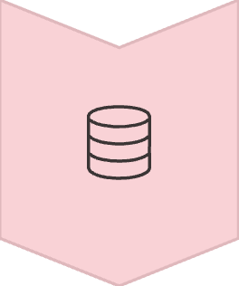

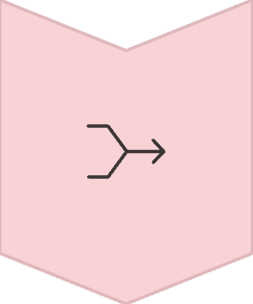

Summary & Next Steps
This pipeline delivers a production-ready foundation for unified enterprise analytics post-acquisition.
Ingest
Raw child data lands in Bronze with full lineage
Clean
Silver layer standardises schemas and quality
Merge
Gold unifies parent + child into one trusted model
Deliver
Dashboards and Genie AI for real-time insights
Built with Databricks Lakehouse · Medallion Architecture · Delta Lake · SQL + Python

